Slide 1
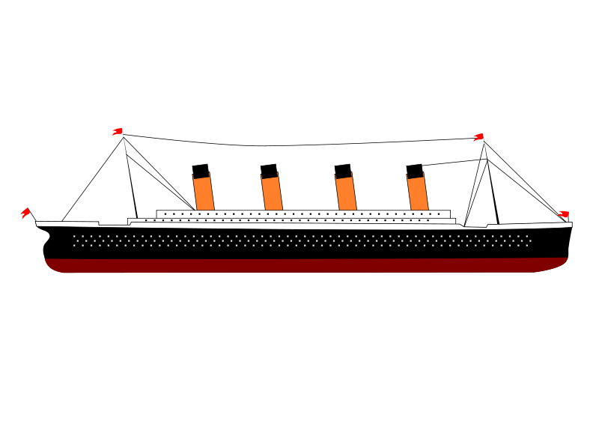
Titanic
Group 1- Children of Jupyter
Cullin Flynn, Christine Kitchens, Erika Lewars, Rick Sadowski, Kira Livingston

Slide 2










Slide 3
The RMS Titanic was an iconic, heralded passenger liner that sunk over the North Atlantic ocean on April 15, 1912. When the ship - which weighed over 100 million pounds and was the largest in the world at the time - met its fate, over 68% of the passengers and crew perished; however, over 700 of the two-thousand-plus passengers were saved and survived the wreck. Survival depended on many factors, but some factors may have influenced survival more than others. In our interactive web interface, users will be able to create a fictional character on the Titanic ship, and based on information such as class, sex, and more, find out if our unique model predicts that the person would have survived or perished if they were on the Titanic's ill-fated maiden voyage!

Slide 4
THE WHY? Questions we hope to answer with Data
We will be using machine learning to create a model that predicts which passengers survived the Titanic shipwreck. Our team selected this topic because we wanted to obtain a deeper understanding of the tragedy and how different passenger attributes impacted their odds of survival.

Slide 5
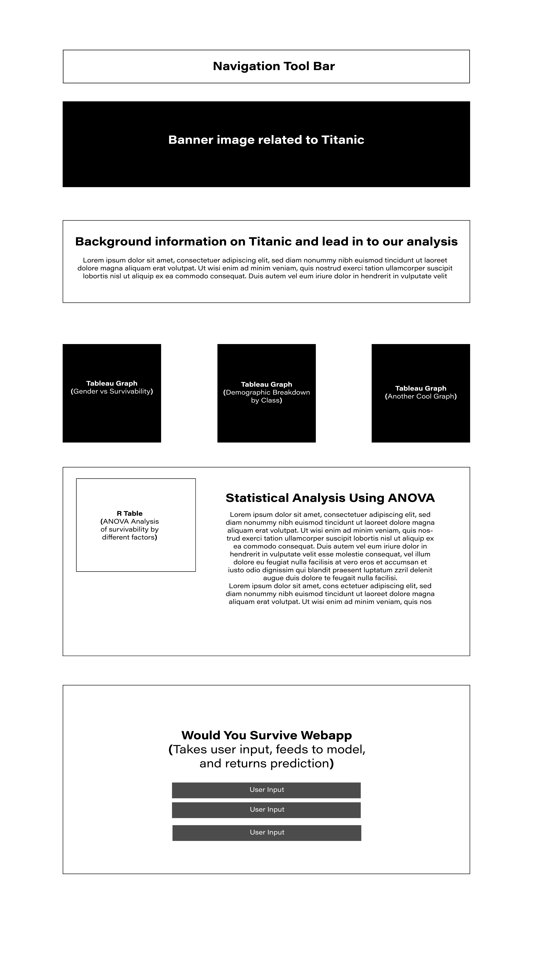
Storyboard

Slide 6

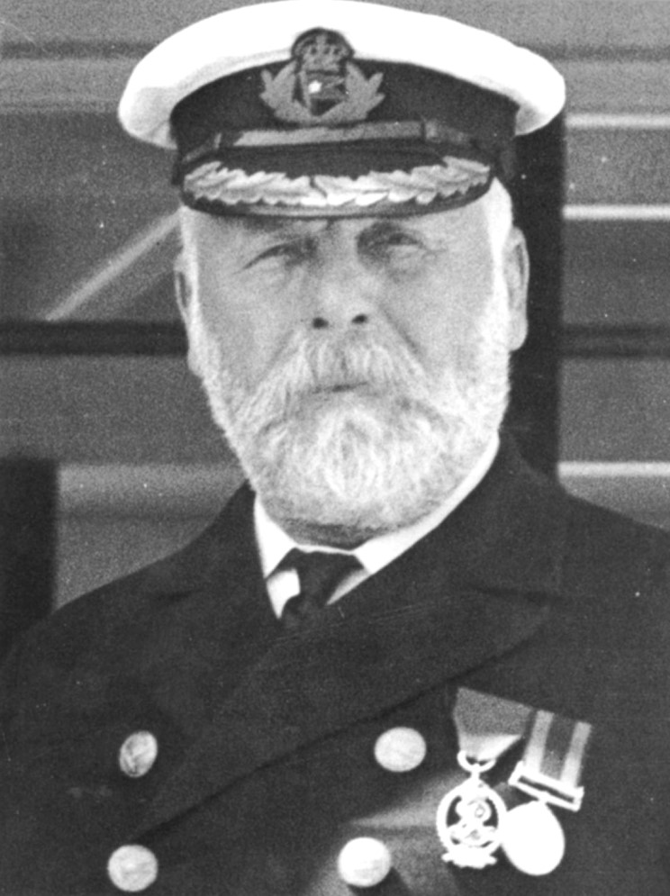
Data
After discussing several titanic resource files, we decided to download the dataset through the r package “stablelearner”.
This dataset seemed to be the most complete source by including all passengers, including the crew on board the RMS Titanic.

Slide 7
Exploration of the Data Set
Several situations existed that we needed to address prior to feeding the data frame in to the machine-learning model.
Class, in the dataset, was first, second, third, and then several different crew roles. We used pandas to change all crew to “crew” because the purpose of our model is not to differentiate results by crew type, and minimizing the values will help us from having too many values.
We then dropped the ‘name’ and ‘ticktetno’ columns because we determined these values are not needed for our analysis.
Next, we set the gender column to a numerical “1” for male and “0” for female to help with our model.
Then, we noticed that the country of nationality for the passengers came from several dozen countries, with many having only a few passengers. To address this, we grouped all countries with less than 50 passengers by continent, creating 12 buckets for country.

Slide 8
How to handle Null Values
We had an interesting concern around null values, as the “parch” and “sibling” columns, indicating if a passenger had relatives on the boat, contained 900 null values out of about 2,200 records. Additionally, the “fare” column had 916 null values.
Our choices were to remove these columns completely, which means that we won’t do analysis on these columns; or, remove these many rows with no data and everything else that goes with it, limiting the number of records in the dataset from 2,200 to 1,300.
We ultimately decided to remove the columns and perform the analysis on the larger dataset with the remaining columns. Due to the dataset of Titanic passengers being relatively small for machine learning already, removing some columns and doing a more robust on the remaining columns was more desirable.

Slide 9

The End
DATA ANALYSIS
BOOTCAMP

